Slide 1
House Rent Forecasting: Using LSTM Network

Slide 2
Content
Introduction
What is LSTM Keras model?
Data Collection and Preprocessing
Data Set Overview
Descriptive Statistics
Data Visualization
Building the LSTM Keras model
Training and Testing the model
Conclusion
Refrences

Slide 3

Introduction
The rent of a housing property depends on a lot of factors like:
Number of bedrooms, hall, and kitchen
size of the property
the floor of the house
area type
area locality
City
furnishing status of the house.

Slide 4

What is LSTM Keras model?
LSTM (Long Short-Term Memory) is a type of Recurrent Neural Network (RNN) architecture that is well suited for sequence prediction problems. It is capable of learning long-term dependencies in data and has been successfully used in various applications such as speech recognition, language translation, and stock price prediction.
Keras is an open-source neural network library written in Python. It provides a simple and easy-to-use interface for building and training deep learning models. Keras has become one of the most popular deep learning libraries due to its ease of use, flexibility, and scalability.

Slide 5

Data Collection and Preprocessing
Before we can build our LSTM Keras model, we need to collect and preprocess the data. We will be using a dataset that contains information about houses such as the number of bedrooms, bathrooms, and size. We will also collected data based on the area locality, such as the pin code and type.
Once we have collected the data, we need to preprocess it before feeding it into our model. This involves scaling the data, handling missing values, and encoding categorical variables. We will also split the data into training and testing sets to evaluate the performance of our model.

Slide 6
Data Set Overview
BHK: Number of Bedrooms, Hall, Kitchen.
Rent: Rent of the Houses/Apartments/Flats.
Size: Size of the Houses/Apartments/Flats in Square Feet.
Floor: Houses/Apartments/Flats situated in which Floor and Total Number of Floors (Example: Ground out of 2, 3 out of 5, etc.)
Area Type: Size of the Houses/Apartments/Flats calculated on either Super Area or Carpet Area or Build Area.
Area Locality: Locality of the Houses/Apartments/Flats.
City: City where the Houses/Apartments/Flats are Located.
Furnishing Status: Furnishing Status of the Houses/Apartments/Flats, either it is Furnished or Semi-Furnished or Unfurnished.
Tenant Preferred: Type of Tenant Preferred by the Owner or Agent.
Bathroom: Number of Bathrooms.

Slide 7

Descriptive Statistics
print(f"Mean Rent: {data.Rent.mean()}")
print(f"Median Rent: {data.Rent.median()}")
print(f"Highest Rent: {data.Rent.max()}")
print(f"Lowest Rent: {data.Rent.min()}")

Slide 8
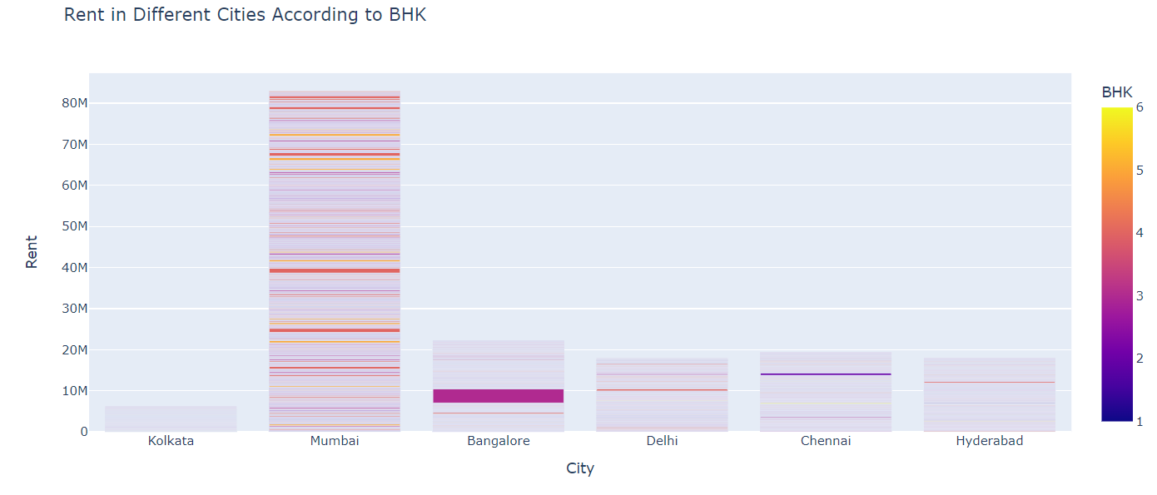
Data Visualization
figure = px.bar(data, x=data["City"],
y = data["Rent"],
color = data["BHK"],
title="Rent in Different Cities According to BHK")
figure.show()

Slide 9
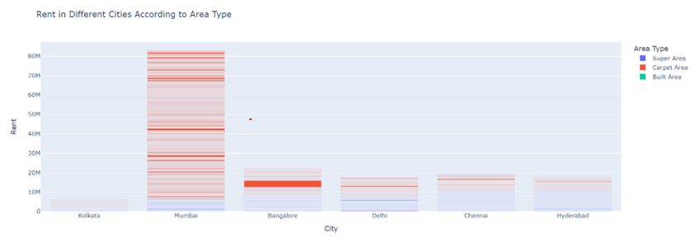
figure = px.bar(data, x=data["City"],
y = data["Rent"],
color = data["Area Type"],
title="Rent in Different Cities According to Area Type")
figure.show()

Slide 10
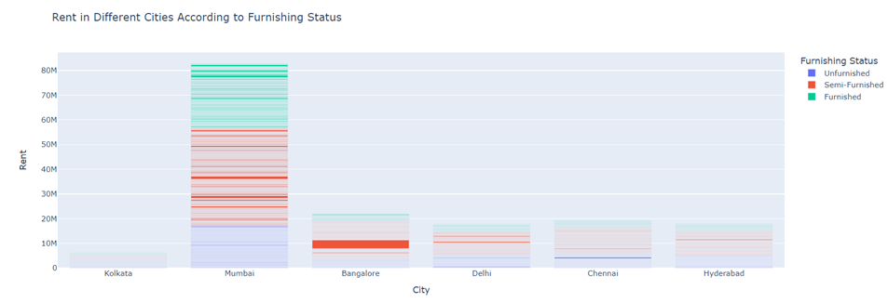
figure = px.bar(data, x=data["City"],
y = data["Rent"],
color = data["Furnishing Status"],
title="Rent in Different Cities According to Furnishing Status")
figure.show()

Slide 11
Building the LSTM Keras Model
Now that we have preprocessed the data, we can start building our LSTM Keras model. We will be using a sequential model with several layers of LSTM cells. The input layer will take in the preprocessed data, and the output layer will predict the rent price of the house.
We will also add additional layers such as dropout layers and dense layers to improve the performance of our model. Once we have built the model, we will compile it and set the appropriate loss function and optimizer.

Slide 12

Training and Testing the model
After building the model, we need to train it on our preprocessed data. This involves feeding the training data into the model and adjusting the weights and biases of the model to minimize the loss function. We will also monitor the performance of the model on the validation data to prevent overfitting.
Once we have trained the model, we can test it on the testing data to evaluate its performance.

Slide 13

Conclusion
In conclusion, the House Rent prediction model using LSTM Keras model is a tool for predicting the rent prices of houses. With the help of this model, we can make the process of finding a suitable house easier and more efficient.

Slide 14
References
https://www.kaggle.com/datasets/iamsouravbanerjee/house-rent-prediction-dataset
https://www.irjet.net/archives/V6/i4/IRJET-V6I4677.pdf
https://www.ijraset.com/research-paper/prediction-of-house-price-using-mi

Slide 15
Thank you

